Slide 1

Introduction to
Web CMS

Slide 2
What is Content
Content: Content is any information that is being distributed. A book, a magazine article , and the information on a website are all content.

Slide 3
What is CMS?
Computer Program
Perform variety of different tasks
Shared repository
Standard Format

Slide 4
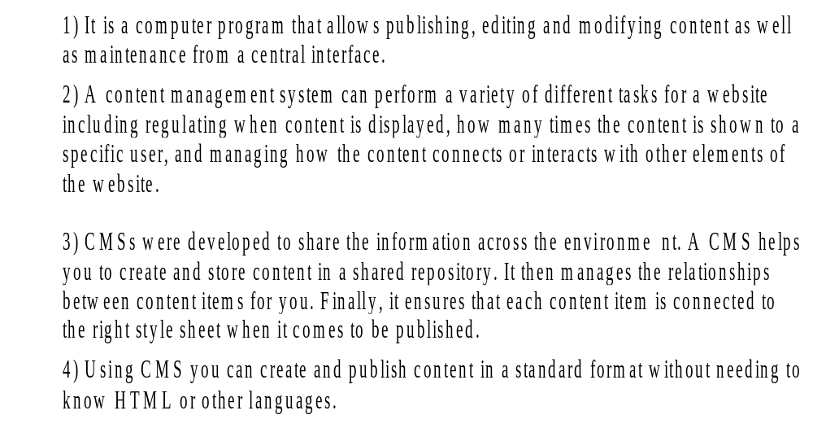
What is CMS?

Slide 5

Hotel Management System

Slide 6
Functionality Hotel Management System
Reservation
Front Office House Keeping
Store
Room Status Account
Checked out Guest
Extension wise Telephone Calls
Check-In
Passport Details
Mini Bar
Availability Status
Room Booking
Function / Event Booking
Arrival List
Booking Chart
Detailed Booking Chart
Bookings of Travel Agency / Company
Follow-up Report
Booking Confirmation Letter

Slide 7

Library Management System

Slide 8
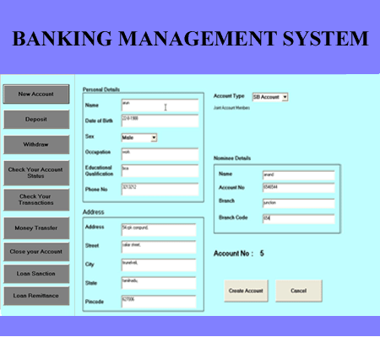
Banking Management ystem

Slide 9
Roles & Responsibilities in CMS
Creator
Editor
Publisher
Administrator
Consumer, Viewer or Guest

Slide 10
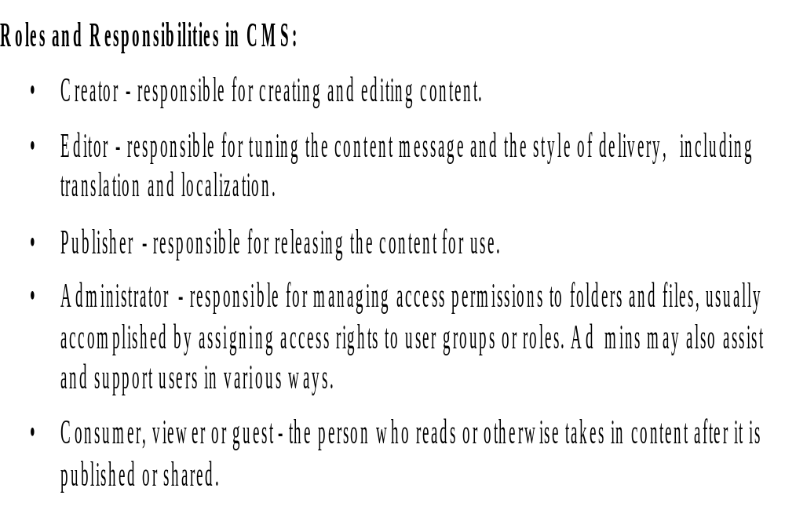

Slide 11
Elements of CMS
CMS
CMA
CDA

Slide 12
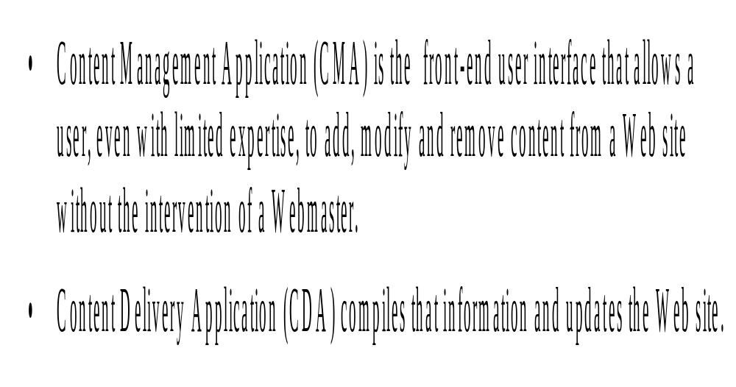

Slide 13
Functions of CMS
Present Information
Web based Publishing
Format Management
Indexing, Search & Retrieval
Serve a central Repository

Slide 14
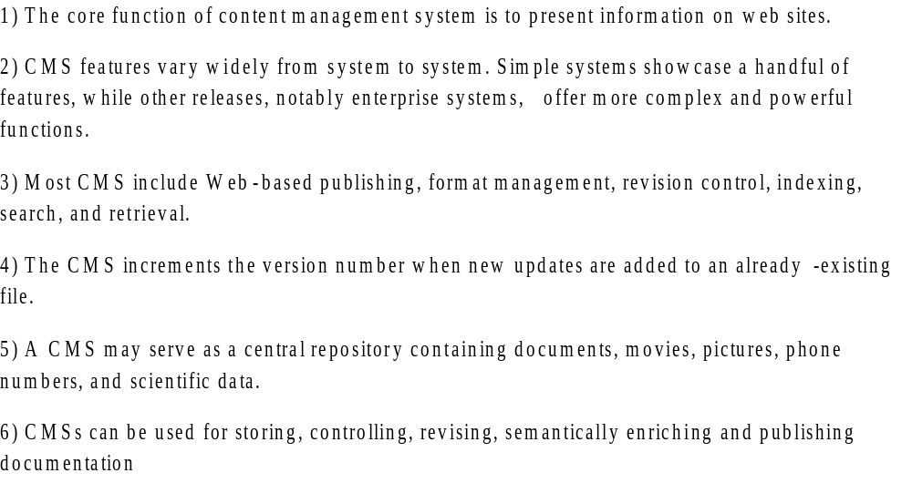
Functions of CMS

Slide 15
Features of CMS
Single-source functionality – each chunk of content is stored only one time in a single repository, enabling maximum content reuse and eliminating duplicate content.
Content reuse - ability to reuse content across multiple documents without duplicating it and to have immediate access to reused content.
Digital asset management - users store and organize graphics and multimedia files within the CMS and search for them based on assigned metadata.
Remote access - remote users access the system through a secure Web interface.
Authorized access control - system administers assign user privileges and roles, allowing users to only access the content they are authorized to use.
On-site training and ongoing customer support - implementation goes smoothly and future questions get answered.

Slide 16
Features of CMS
Import and Creation of Documents & Multimedia Material
Identification of key users and their roles
Ability to assign roles and responsibilities to different instances of content type
contd...

Slide 17
Features of CMS
Ability to track and manage multiple versions of single instance of content
Ability to publish content to repository

Slide 18
CMS Architecture
User Interface
(to create, modify, and manage content)
Content Access
to get access to the content and the content management features of the CMS.
Business Logic and Data Access Layer
Content
Admini-
stration
Content Management
functionalities for the definition of the domain or application specific Content Data Model.
Content Data Model
the representation of content and their persistent to be customer scenario.
Database
Content Repository

Slide 19
CMS Architecture
CMS architectures are built upon the concept of a 3-tier architecture with client, CMS server, and database backend. Above Figure shows the architecture of a CMS.
The main difference of CMSs compared to other information systems is to focus on flexible content modeling and storage.
A CMS User Interface at the top layer presents the content and offers editorial features to create, modify, and manage content within its lifecycle.
Access to the content itself is provided by a Content Access layer. This layer is used by the User Interface to get access to the content and the content management features of the CMS.

Slide 20
CMS Architecture
The core management features are implemented in the Content Management layer. This layer provides functionalities for the definition of the domain or application specific Content Data Model. Access control and content lifecycle definitions are further typical management features implemented in this layer.
The Content Data Model layer is conceptually placed below the Content Management layer that has the necessary features to manipulate the model. The Content Data Model is the application specific model based on the underlying Content Repository. Content data model is the representation of content and their persistence need to be highly adaptable to any domain or customer scenario.
The Content Repository defines the fundamental concepts and persistence mechanisms for any Content Data Model that is defined on top.
The Content Management features are tightly related to the Content Administration layer to administer the CMS stack.

Slide 21
Advantages of CMS
Ability to add or edit pages
No need to pay developer for maintenance
These systems can also be easily installed.
CMS offer a low cost solution to running and operating a website.
Almost any database can have CMS applied, as well as the software being easy to migrate to different servers.

Slide 22
Disadvantages of CMS
Potential to break look and feel of website
Minimum computer skills required
Unavailability of resources to update

Slide 23
Types of CMS
Types OF CMS
Proprietary CMS
Open Source CMS

Slide 24
Types of CMS
1. Proprietary CMS -
Single Admin :-A proprietary CMS is a content management system in which the back end code is available only to the particular developer, so only the single Admin can edit or customize the webpage.
Need License :- Many companies sell licenses to use their own proprietary CMS.
Restricted Access :- For Specific Files and Folders.
Database Driven:- content management system website that the website owner can login to and make changes.
Development Costs :- CMS is that development costs and monthly fees are much higher than an open source solution.
  e.g., Yahoo Store, Ektron, SiteCore, Kentico

Slide 25
Adv-Dis Adv of Proprietary CMS
Benefits of a Proprietary CMS
Support – this is what you pay for, you generally will have access to a team of people who know the CMS code inside and out.
Setup – you can probably have the third party company offering the CMS setup your website, no need to go searching for talent else where.
Drawbacks of a Proprietary CMS
Licensing Fees – A lot of proprietary content management systems require that you pay a licensing fee or at least a setup fee vs an open source cms that is free to use.
Tied to proprietary developer – What’s worse is that you have to depend on that company to create upgrades and new features.

Slide 26
Types of CMS
2. Open Source CMS -
  Open System
  No License required
  Free to download
  Backup & Save website database & files
  e.g., Wordpress, Joomla, Drupal

Slide 27
Advantages of Open Source CMS
Low cost
Flexible & Easy to customize
Ability to share resources
Trial Evaluation

Slide 28
Disadvantages of Open Source CMS
Weakness in system design
Little/No supporting documentation
Risk of over-personalization

Slide 29
Types of Open Source CMS
Open Source CMS
Web CMS
Component CMS
Enterprise CMS

Slide 30
Types of Open Source CMS
Web content management system –
A web content management system (web CMS) is a bundled or stand-alone application to create, manage, store and deploy content on Web pages. Web content includes text and embedded graphics, photos, video, audio, and code (e.g., for applications) that displays content or interacts with the user.
A WCMS promotes collaboration among users by allowing multiple-author editing of content.
Component content management system -
A component content management system (CCMS) specializes in the creation of documents from component parts. These components can be reused (rather than copied and pasted) within another document or across multiple documents.
Enterprise content management systems -
An enterprise content management system (ECM) organizes documents, contacts and records related to the processes of a commercial organization.

Slide 31
What is Web CMS?
Software System
Use content Repository
Set of templates
Administration through browser-based interfaces
New features can be added

Slide 32
Features of Web CMS
Automated templates
Access Control
Scalable Feature Set
Collaboration
Document Management
Multilingual

Slide 33
Types of Web CMS
Web CMS
Offline Processing
Online Processing
Hybrid Systems

Slide 34
Types of Web CMS
Offline processing:
These systems pre-process all content, applying templates before publication to generate web pages. Since pre-processing systems do not require a server to apply the templates at request time, they may also exist purely as design-time tools.
Online processing:
These systems apply templates on-demand. HTML may be generated when a user visits the page or pulled from a web cache.
Hybrid systems:
These systems combine the offline and online approaches.

Slide 35
Advantages of Web CMS
Low cost
Easy Customization
Easy to use
Workflow Management

Slide 36
Advantages of Web CMS
Low cost –
Some content management systems are free, such as , , , and . Others may be affordable based on size subscriptions.
Easy customization -
A universal layout is created, making pages have a similar theme and design without much code. Many CMS tools use a drag and drop system for their design modes. It makes it easy for beginner users to create custom front-ends.
Easy to use -
CMSs are designed with non-technical people in mind. Simplicity in design of the admin allows website content managers and other users to update content.
Workflow management –
Workflow management – is the process of creating cycles of sequential and parallel tasks that must be accomplished in the CMS. For example, one or many content creators can submit a story, but it is not published until the copy editor cleans it up and the editor-in-chief approves it.
CMSs provide the facility to control how content is published, when it is published, and who publishes it.

Slide 37
Disadvantages of Web CMS
Cost of implementation
Cost of maintenance
Latency Issues

Slide 38
Disadvantages of Web CMS
Cost of implementation -
Larger scale implementations may require training, planning, and certifications. Certain CMSs may require hardware installations. Commitment to the software is required on bigger investments. Commitment to training, developing, and upkeep are all costs that will be incurred for enterprise systems.
Cost of maintenance -
Maintaining CMSs may require license updates, upgrades, and hardware maintenance.
Latency issues -
Larger CMSs can experience latency if hardware infrastructure is not up to date, if databases are not being utilized correctly.

